Slide 1
Front-End Development for the MPC in the Cloud Sprint-1
QingXing Li, Yicun Hou, Haoyu Xu
Mentors: Joseph Caiani, Máirín Duffy

Slide 2
Introduction
The main project is the front end of ChRIS(ChRIS Research Integration System) project
ChRIS enables users who are not familiar with image processing able to process the medical image with a single click.
MPC(Multi-Party Computation) : a method for parties to jointly compute a function over their inputs while keep input private.
Notes:
the ChRIS project - an open source, cloud-based medical imaging platform
ChRIS:Children's Research Integration System
MPC:these researchers would like to be able to easily compare the volumes of brain structures in a set of brain scans with the volumes across a larger body of scans from different medical institutions. but those medical institutions cannot share patient data, such as brain structure volume, with other institutions.

Slide 3
Introduction
Users
Neuroscience researchers at medical institutions in Boston area focusing on the brain volume.
Not neuroscience or other researchers looking to perform MPC on other types of calculation
Features
Privacy: Each user has their unique credentials.
Security: The data cannot be accessed by different institutions.
Notes:
Users are looking to identify structures in the brain that have a volume outside of the norm across different participating institutions via a secure multi-party compute (MPC) algorithm.

Slide 4
Main Tasks
Update the Chris-store UI with Redux.
Design a user-friendly front-end interface using React & Redux.
MVP: Display MOC calculation results to the users.
Challenge: Visualize the MOC processed brain image.

Slide 5




Detailed Diagram
Data retrieval plugin
Compute Environment
(MOC)
ChRIS Store
Data manipulation
plugin (MPC)
Data Source
(Hospital)
ChRIS UI (Front-End)
Input
Input
Plugins
Output
Output
Back-end
Notes:
Here is a detailed diagram of the whole ChRIS system, basically there are 4 units: the data source(usually in the hospital), the ChRIS Store, the ChRIS Ul and the compute environment (which would be like the MOC).
In here, I want to introduce the a terminology called plugin. Plugin is a containerized set of image processing software. For example, while using photoshop, you may need to filter the image or adjust the contrast, each function is just like a plugin of ChRIS. Actually you can treat the ChRIS Store as an app store and users can take the needed plugins from ChRIS Store. While using the ChRIS system, ChRIS UI will take the data from the data source and push it to the compute environment. Then, the user will select a series of plugins for the image processing. At the same time, the ChRIS UI will push the plugins to the Compute environment as well. After the calculation, the MOC will produce an output and push it back to ChRIS UI. Then the ChRIS UI will display the calculation Result. So our main tasks are in the dotted line area.

Slide 6
Why choose React?
Special syntax called JSX -- a syntax extension, which allows mixing HTML with JavaScript
Virtual DOM in React makes user experience better and developer’s work faster
Notes:
Our project is a cooporation project with RedHat. A Part of the whole ChRIS project
ChRIS:Children's Research Integration System
MPC:A small example is that of a group of people desiring to compute their average grad, without any individual group member revealing her personal grad to the others, we need someone who we can trust and can calculate fast, and that’s prof Krigger~

Slide 7
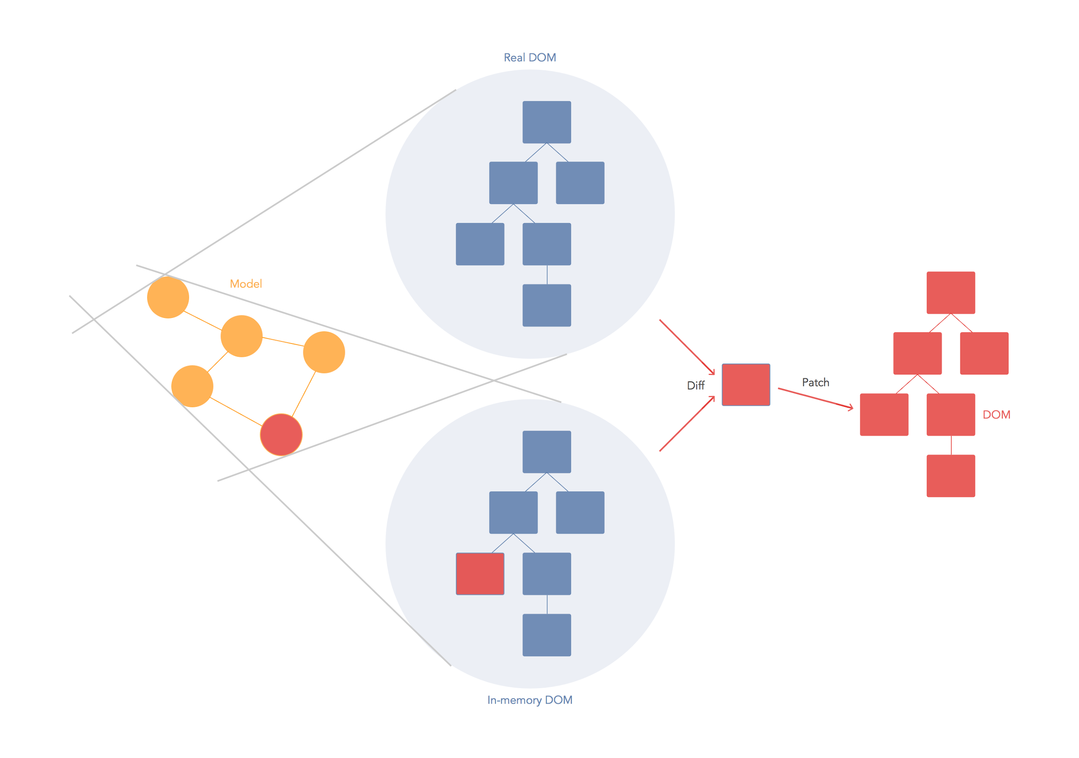
Virtual DOM Workflow
Notes:
This picture illustrate how virtual dom works, think we have thousands of divs in dom, a event handler want to find every node interested node on the event and update it, maybe it needs to traverse it manually, it very consuming. In React, for every DOM object, there is a corresponding "virtual DOM object." A virtual DOM object is a representation of a DOM object, like a lightweight copy. Manipulating the DOM is slow. Manipulating the virtual DOM is much faster, because nothing gets drawn onscreen. So when we change the state of a component, it first changes the virtual dom and the compute diff algorithms to detect the change and then update the real dom.
The Document Object Model (DOM) is a programming interface for HTML and XML documents. It represents the page so that programs can change the document structure, style, and content. The DOM represents the document as nodes and objects.

Slide 8
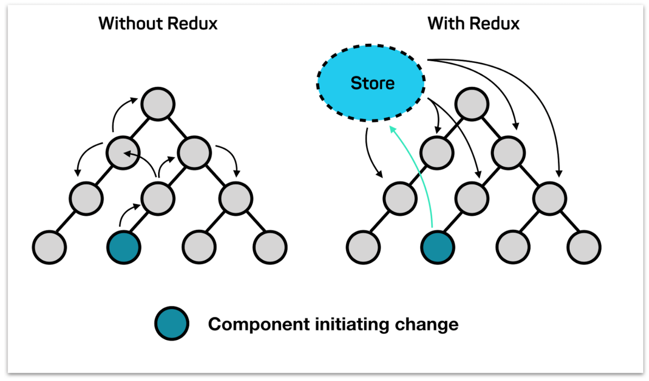
React without Redux and with Redux
Notes:
Let’s think we want to build a huge application with only react,
Root component want to communicate with the children component
Children component call father’s component method, pass data to it… if a application has huge amount of components, and components will pass value from each other, it will become troublesome. So this is why react is a light-weight view layer framework, it cant to build big application. So this is why we need redux, in this picture, redux store the component data in the store, and if the children’ component data changes, the father component will sense the change and update data from the store, so we dont need to pass data between component, then we can make big application using react and redux. Boilerplate

Slide 9
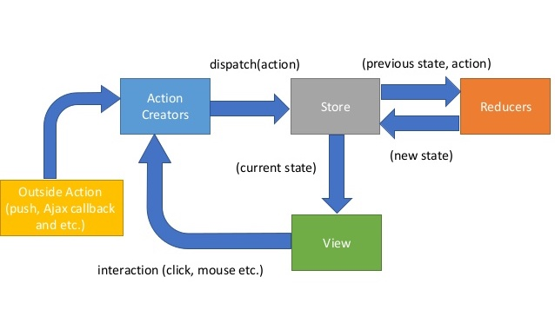
Redux workflow
View: connected with react component and triggers some interactions.
Actions Creators: dispatch actions to store, store will automatically send it to reducer.
Reducer: reducer will update the state and return new state to store.
Store: store will pass new state to the view, and view will re-render it.
Notes:
View has trigger some event like click the button, it sends it to the action creators, action creators will check, oh, you did this action so i will send this action to store, then store received it and dont know how to handle it, so it will ask reducer for help, it pass component’s previous state and event action to reducer, reducer will help store handle that and then return a new state, so in the last the view will re-render the new state. will help support other MPC calculation projects in th

Slide 10
Sprint 1- What we did
ChRIS background Research
Understood ChRIS system diagram and workflow
Took online courses to learn React and Redux
Set up the ChRIS Store backend in Docker
Rewrited ChRIS Store UI with Redux
Notes:
To be more familiar with the React and Redux, we re-write the ChRIS Store using Redux.
demo

Slide 11
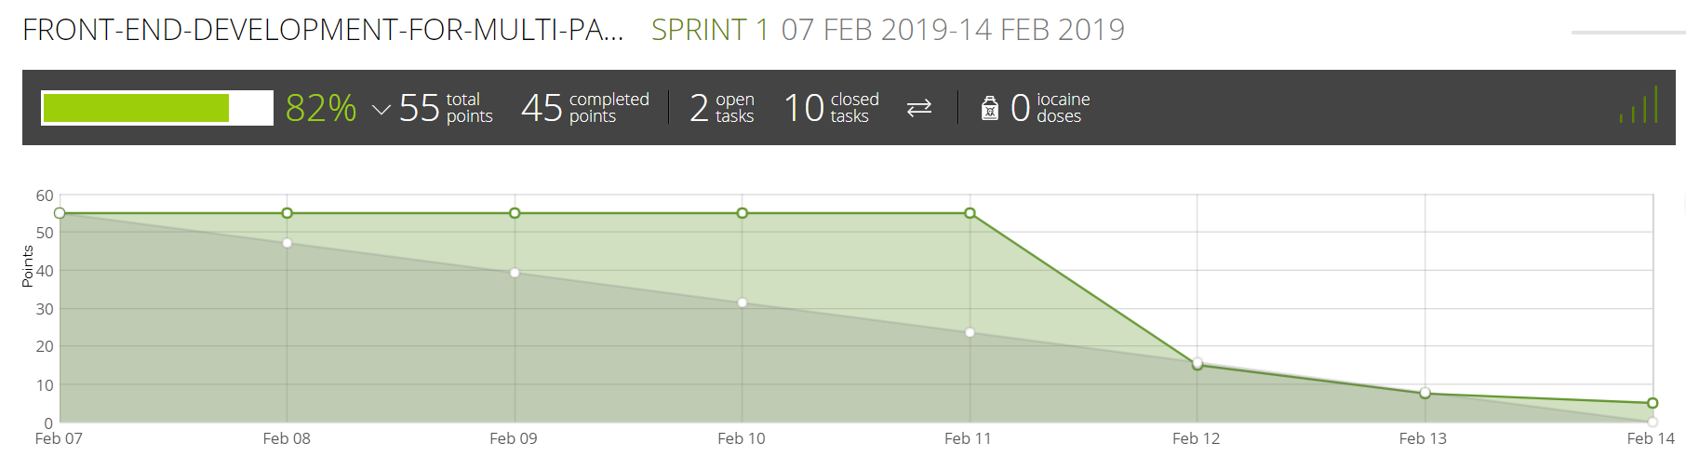
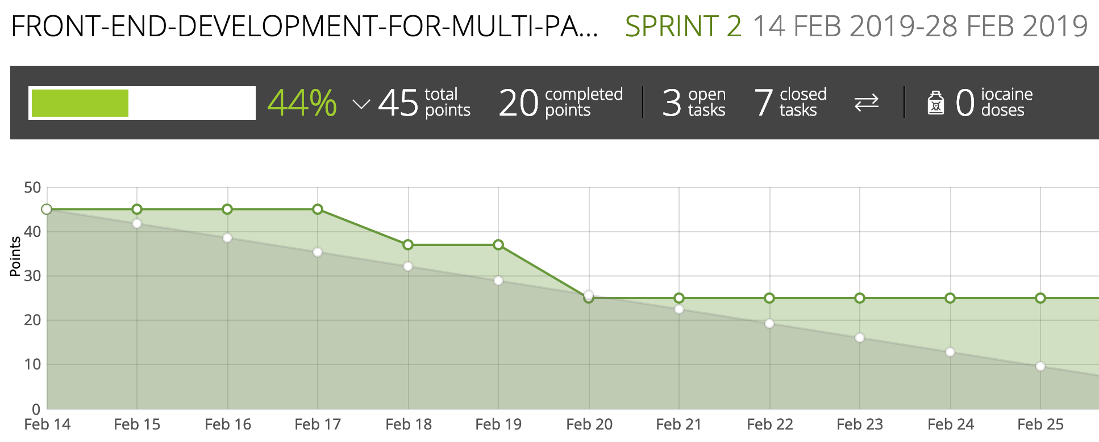
Taiga

Slide 12
Sprint 2- Next to do
Get started to implement ChRIS UI, develop the main component
Write ChRIS UI library with TypeScript

Slide 13
Questions?

